Slide 1
SharePoint Installation
Module 2

Slide 2
Agenda
Farm topologies
Install roadblocks
Accounts and permissions

Slide 3
Topologies
SharePoint scales from a single server install all the way to very large farms of servers
Uses assignment of roles to span multiple servers

Slide 4
Keep in mind
Servers have roles
Web
Query, Index, Calculation
DB Server
Farms have relationships
Authoring
Publishing
Dev, Test, Production
SSP

Slide 5
SharePoint Containment
Farm
Web Front End, APP, SQL
Web Applications
Databases
Site Collections
Sites
Lists
Items
Content, Config, SSP, Search
Central Admin, SSP Admin, Content
Servers
Internet, Intranet Portal, Wikis, Blogs, Team, Doc, Mtg
Wikis, Blogs, Team, Doc, Mtg
Doc Lib, Pages, Events, Discussions, Surveys, etc…
Files, calendar items, contacts, customers, images, custom

Slide 6
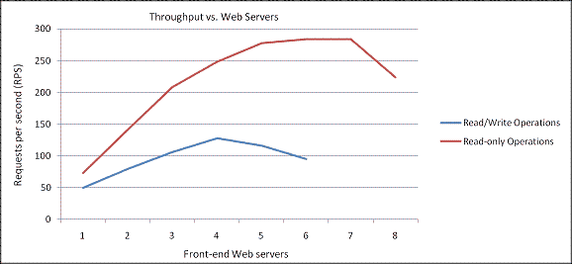
Web Front End Role
Called WFE
Provides the web interfaces for the users
1 to 8 servers with this role per farm
Very little disk storage used
Scaling seems to stop at 5 for collab
Notes:
http://technet2.microsoft.com/Office/en-us/library/a76963dc-1cd0-4aff-ae9c-3736d89c42441033.mspx

Slide 7
Index Role
Crawls and indexes the content
1 Index per Server
1 Index per SSP
Index Files = 5% - 12% of crawled content
1% - 5% typical if only crawling SharePoint
Database Storage = 4 x Index Files
50 Million item tested limit
Notes:
http://technet2.microsoft.com/Office/en-us/library/5465aa2b-aec3-4b87-bce0-8601ff20615e1033.mspx

Slide 8
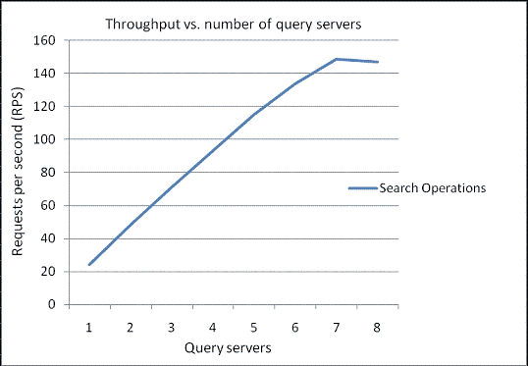
Query Role
Server that responds to user Search request
Physical storage = 2.8 x Index
No hard limit on number of servers
Scale stops at 7
Notes:
http://technet2.microsoft.com/Office/en-us/library/5465aa2b-aec3-4b87-bce0-8601ff20615e1033.mspx?mfr=true

Slide 9
Excel Calculation Role
In MOSS Enterprise farm this server handles calculating Excel Workbooks
Also called Application Server
Rendering components live on WFEs
Calculation engine moved to own server
No limit to number of servers
Sizing is very complex
Notes:
http://technet2.microsoft.com/Office/en-us/library/fb6928ce-49f8-492a-abff-5bd00ed588e21033.mspx?mfr=true

Slide 10
Topologies
Spread the roles out across as many servers as you need and have at it.
No restrictions

Slide 11
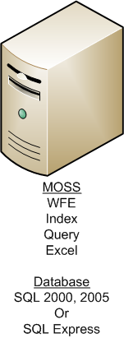
Single Server Farm

Slide 12
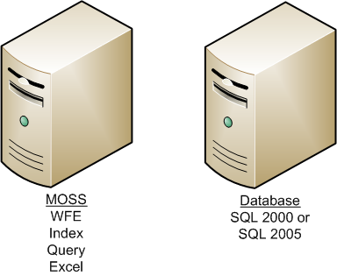
Small Farm

Slide 13
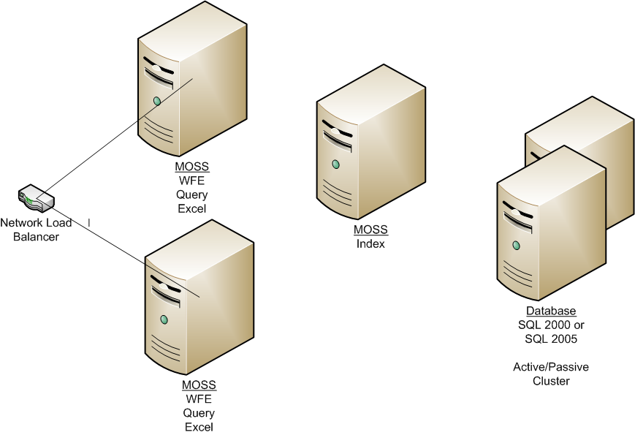
“Medium Farm”
Considered Minimum High Availability Topology

Slide 14
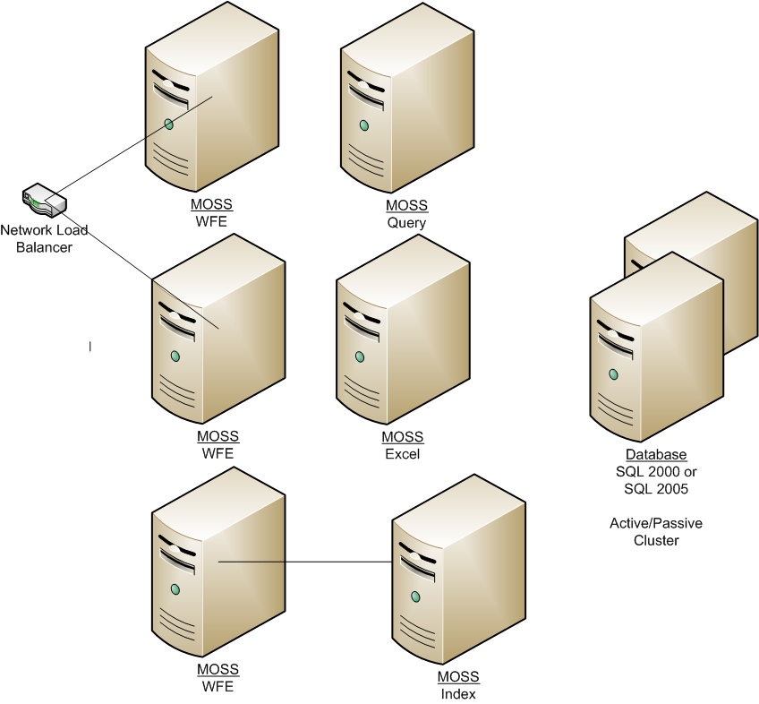
A Possible Large Farm

Slide 15
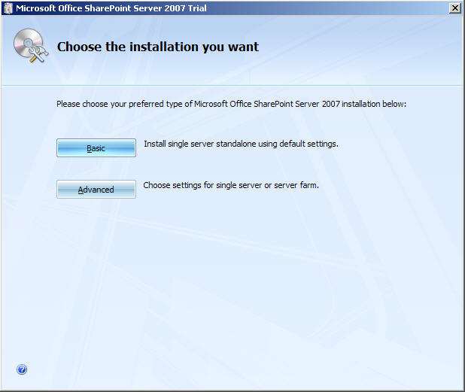
Don’t choose Basic!
Unless you want to use SQL Express and Local System Account

Slide 16
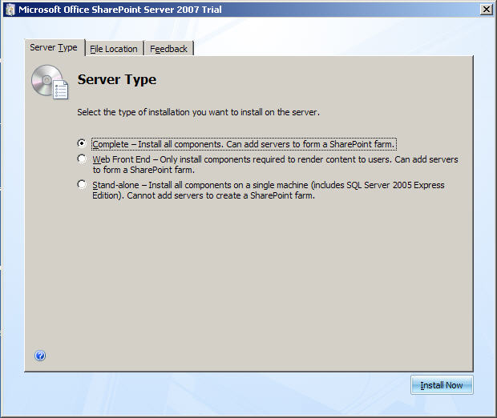
Server Type
Complete – Used 99.9% of the time. Installs all components and gives you complete configuration flexibility.
Web Front End – Only installs web components of MOSS. Doesn’t give you the option of later hosting other roles. No Flexibility = bad.
Stand-alone – Exact same as previous slide choosing basic. Refer to that slide if you are tempted to use.

Slide 17
Install Accounts
First choice – 1 account for everything or account isolation
Account isolation has lots of challenges
Second Choice – NTLM or Kerberos

Slide 18
NTLM vs. Kerberos
Kerberos is generally preferred
No double hop problem
More secure
Less authentication traffic
Downside
Requires extra work to setup
Domain needs to be in order (Server time off by > 5 minutes and auth fails)

Slide 19
Accounts you will need (MOSS)
Setup User Account * – Used for running install and to admin server
Server Farm Account * – Central Admin App Pool Account, Timer Service Account
SSP App Pool Account
SSP Service Account – All SSP services and jobs
MOSS Search Account – Used by search service. Also become default content access account for search. You can change from the SSP level
* Account needed for WSS
Notes:
http://technet2.microsoft.com/Office/en-us/library/f07768d4-ca37-447a-a056-1a67d93ef5401033.mspx?mfr=true
WSS Only? http://technet2.microsoft.com/WindowsServer/WSS/en/library/89e4c579-5720-45e0-917e-abeb95266c3e1033.mspx

Slide 20
More accounts (MOSS)
WSS Search Service Account * – Used by the help system crawler
WSS Search Content Account * – Used to access the data by the help system crawler
Application Pool Identities * – The account used to access the content databases for the web app. Also account for w3wp.exe
* Account needed for WSS

Slide 21
SetSPN.exe
Used to define Service Principal Names (SPN)
An SPN is a multi valued attribute stored in AD for users.
Services only know how to use them to request a ticket
Example SPN = HTTP/server.domain.com

Slide 22
Account Setup Before Install
Single account install – Make account local admin on all boxes
Secure multi account Install
Setup Account – Domain User, Local admin on all servers you install MOSS on, SQL Server login with SecurityAdmin and dbcreator roles.
All other accounts – Domain User. Setup/config will automatically grant necessary rights.

Slide 23
Service Pack 1
Available as of December 2007
For more information on how to deploy it
http://msmvps.com/blogs/shane/archive/2007/12/14/how-to-install-wss-and-moss-sp1.aspx

